Slide 1


The Design and Development of C Programming Language
Teacher: Zong Lou

Slide 2
点击添加文本
What’s the C language
点击添加文本
点击添加文本
点击添加文本

Slide 3
The history of Computation

Slide 4
At the very begining, the primitive man can record the number of animals by the stone or stick.

Slide 5
In 1623, the German scientist Schickard (契克卡德) invented the first mechanical calculator.

Slide 6
After that, the France physicist Pascal (帕斯卡) improved the calculator in 1652.

Slide 7
The German mathematician Leibniz (莱布尼茨) make the calculator can compute multiplication and division.

Slide 8
Until to 20th century, global population increase quickly because of the development of science and technology. At that time, people need more complicated computation. So the world's first electronic computer birthed in the University of Pennsylvania in the U.S in 1946.

Slide 9
Now, this is the age of technology.
modern computer technology
network technology
database technology
communications technology
Develop rapidly

Slide 10
Mondern Computer Architecture
The modern computer is based on the von Neumann architecture.
But there is no definite way to differentiate code and data that is resident in memory in it.

Slide 11
How to communicate with the computer?
For example, how can a Chinese people communicate with a Japanese.
1.Record the words in Chinese.
2.Translate it into Japanese.
3.Send the translated words.

Slide 12
If we want to communicate with computer and control it to do something, we shoule “speak” programming language.

Slide 13
Now there are more than 2,500 documented programming languages.
This timeline includes fifty of the more than 2500 documented programming languages.

Slide 14
Java and C are the most stable languages ​​in the industry.

Slide 15
The birth of C
Ken Thompson
Dennis M.Ritchie
The two super game player.

Slide 16
The birth of C
In 1969, Ken‘ s dream was travelling the space, so he designed and develop a game called “Space Travel”.
In 1971, Dennis joined the development of this game.
At that time, the game development was more costly. They have to develop it on a small machine called “PDP-7”, it was free but had not operating system。

Slide 17
Before the development of the game, they decided to design a operating system and called it as “UNIX”.
But low-level language is effiencient, so they designed the C programming language.
They were developing the UNIX os in Bell Labs .

Slide 18
The standard of C
In 1978, published the first book named <The C Programming Language>.
In 1982, the American National Standards institute established a C standard committee.
In 1989, the first standard was published, called C89.
In 1990, the ISO accepted it and renamed it as C90.
In 1999, the ISO improved it and published it as C99.

Slide 19
Why to study the C language
The C is a high-level language, but it not purely high level and it operate efficiency.
We can know the basic principle of computer by learning the C.
Many popular language were designed with the thinking and grammar of C, such as Java.

Slide 20
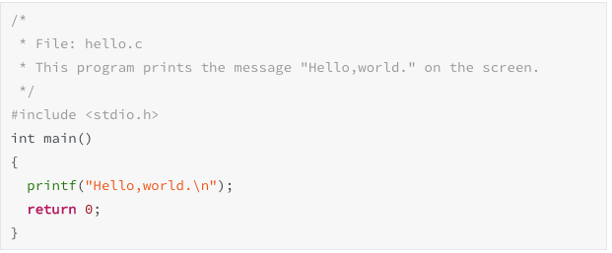

Slide 21

After-class assignments
Q1. Programming question
Write code to print some words what you want to say on the screen.
Q2.Short-answer question
What is the application domain of C language, or we can use the C to do what?
Q3.Optional question
How the C language works?

Slide 22
Goodbye!

